Slide 1
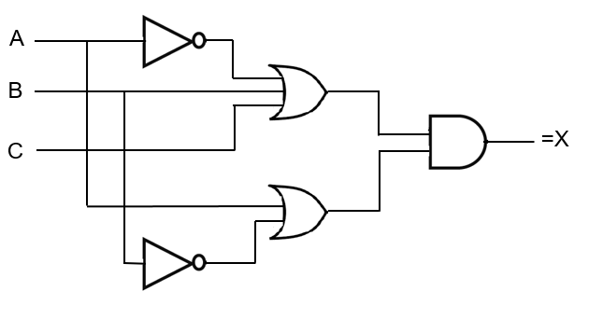
-A
-
B
-A+B+C
+
C
*
A
(-A+B+C)*(A+-B)
+
A+-B
-B
-

Slide 2
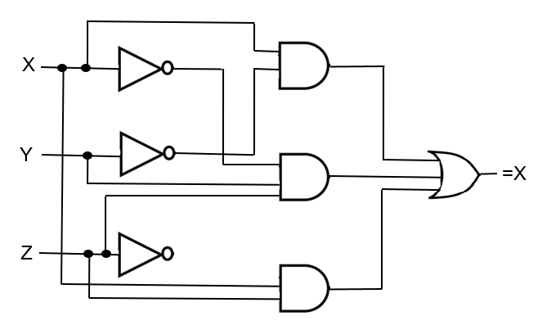
(X-Y-Z)
-X
-
X
*
-Y
-Z
-Y
(-XY Z)
-
-X
+
*
Y
(X-Y-Z)+(-XYZ)+(XZ)
Z
-
-Z
X
(X Z)
*
Z

Slide 3
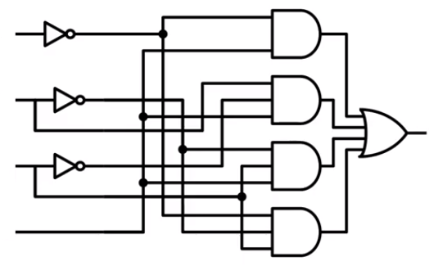
-A
-A
A
*
D
(-A D)
-B
B
B
*
(B -C D)
-C
D
+
-C
-B
(-AD)+(B-C D)+(-B C D)+(-A-B C)
C
*
C
(-B C D)
D
D
-A
D
-B
*
(-A-B C )
C

Slide 4
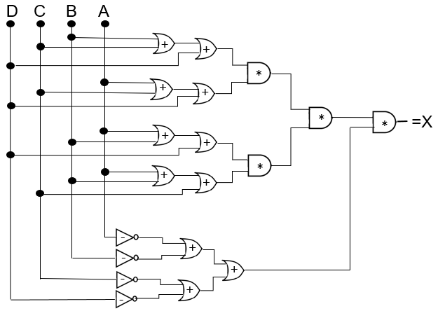
B
C
B+C+D
D
A
A+C+D
(B+C+D)(A+C+D)
C
D
A
B
A+B+D
(A+B+D)(A+B+C)
D
A
B
(B+C+D)(A+C+D)/(A+B)
A+B+C
C
-A
-B
-A+-B+-C+-D
-C
-D
(B+C+D)(A+C+D)(A+B+D)(A+B+C) (-A+-B+-C+-D)

Slide 5
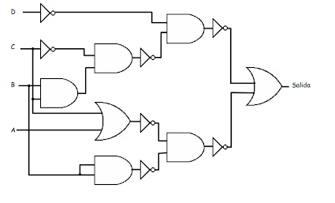
-D
D
(D B)
-C
B
C
B
B C
(DB)+(A+C)(B)
-A+
-C
(A+C)(B)
-B

Slide 6
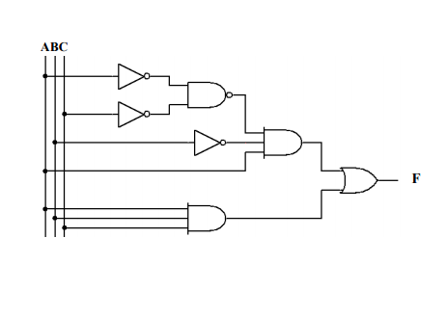
-A
(-A/-C)
-C
(-A/-C)(-BA)
-B
A
(A B C)
(-A/-C)(-BA)+(A B C)

